Slide 1
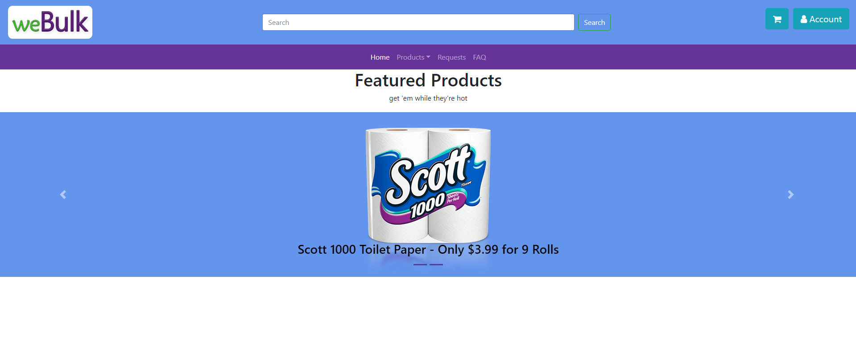
Lavender Dangerous presents: weBulk

